Slide 1
Housing Price Analysis
Statistical Modeling Presentation

Slide 2
Overview
Housing Price Data Description
Hypothesis Testing (Pearson’s test)
Data Analysis (Preprocessing)
Outlier Removal (Z-Score)
Linear Model building

Slide 3
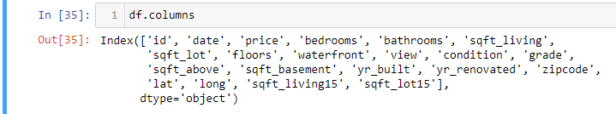
Data Description
Housing Price prediction Data contains various attributes of House that available for sale.
It contains more then 20000 house data.
Each data point contains more then 20 information related to house (ID, price, area etc..)
Objective to Determine the linear dependency of each feature with house prices.
To design a model that predicts House price given the related attributes.
Find out the parameters of model.

Slide 4
Hypothesis Testing (Pearson’s test)
Tests whether two samples have a linear relationship.
Assumptions
Observations in each sample are independent and identically distributed (iid).
Observations in each sample are normally distributed.
Observations in each sample have the same variance.
Interpretation
H0: the two samples are independent.
H1: there is a dependency between the samples.

Slide 5
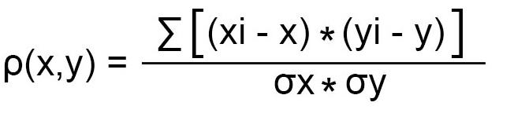
Pearson’s correlation coefficient
Let we are having two sequence of continuous data X and Y.
Pearson's correlation coefficient
r = covariance(X, Y) / (stdv(X) * stdv(Y))
The value can be differ from -1 to 1.
If two sequences are same then the value is 1 if two data are completely independent then the coefficient value nearly zero
Positive value refers to positive correlation where negative value refers to negative correlation.

Slide 6
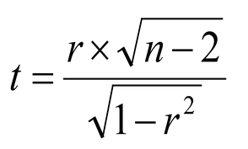
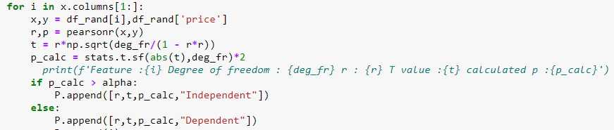
Pearson’s Test Statistic (t value)
we calculate the value of the test statistic using the following formula:
Test statistic:
Where r is the Pearson’s correlation coefficient and n-2 is the degree of freedom.
From the t value we will find out the p value and matching that with our significance level we will accept or reject the hypothesis.

Slide 7
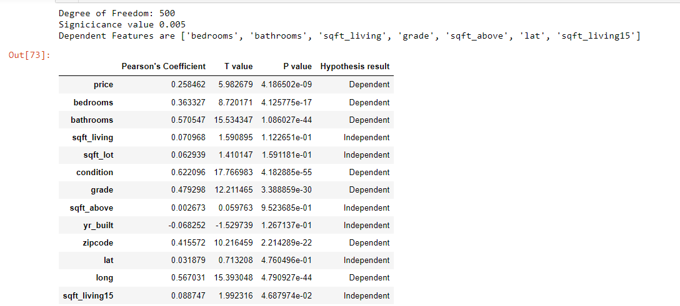
Test Simulation
In order to simulate the result I designed a function that will interpret the degree of freedom and level of significance value.

Slide 8

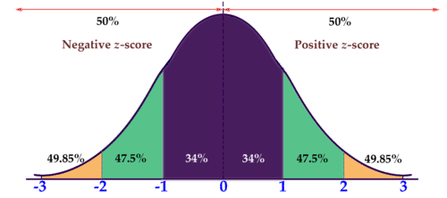
Model Building
Based on hypothesis result some dependent feature will be available by using those features we fit a hyperplane using Linear regression for predicting the prices.
Assumptions : Variance should be same for features
Before applying the algorithm some preprocessing part done for null value and outlier removal process.
Outlier removal
Here I calculated the Z score of the data as with respect to each column.
As we know nearly 99% of the data lies between +/- 3σ (standard deviation) in normal distribution so the values that have absolute Z score value of more then 3 are removed.
Outliers
Outliers

Slide 9
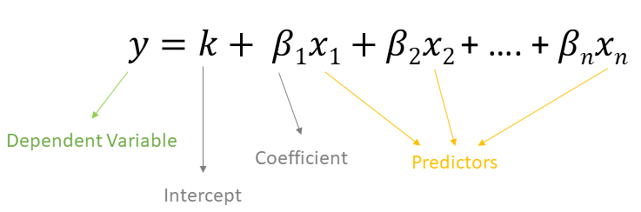
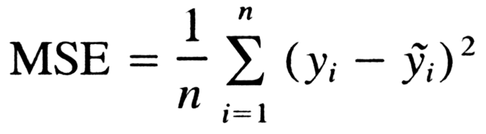
Model Building
Multiple Linear Regression equation given by
After removing the outlier we apply Linear Regression to fit a Hyper Regression line for the data.
Here mean square error is used as loss function .
By minimizing the loss function w.r.t. linear coefficient we will find out the parameter of the model with respect to each attribute.

Slide 10
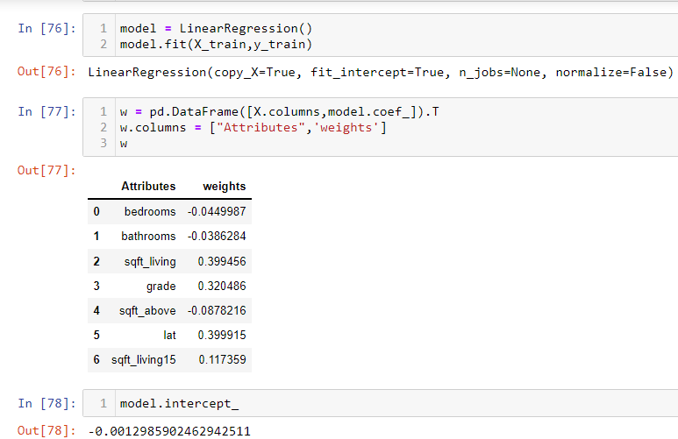
Model

Slide 11
Thank You

